Slide 1
Wendy's Quarterly Business Review
AI Strategy Update

Slide 2
Where Improving Sees Technology & AI Going

Slide 3
The Trust Evolution: 8 Stages of AI Maturity
Productivity
Efficiency
8
7
Orchestrate
6
Supervise
5
Coordinate
4
Delegate
3
Workflow
2
Task
1
Off the shelf
Zero AI
Wave 1: Tools
Wave 2: Process
Wave 3: Agentic Operations
As trust increases, humans shift from doing to directing

Slide 4
The Three Layers of Intelligence OS
LAYER 3
Orchestration infrastructure How you manage 10+ agents at scale
Operating Model
LAYER 2
The safety net for autonomous mode Boundaries, trust, accountability
Governance Engine
LAYER 1
Human expertise + AI working together From tool user to AI operator
Hybrid Intelligence

Slide 5
Improving's Agentic Landing Zone Offering
Assess
Build
Scale
2-4 weeks
6-12 weeks
Ongoing
Current state analysis Use case identification Readiness evaluation Roadmap development
Landing zone deployment Governance framework Initial agent pilots Team enablement
Production deployment Continuous optimization Capability expansion Center of excellence
What Improving Brings:
Deep Cloud & AI expertise • Proven methodology • Enterprise experience
23

Slide 6
Lessons Learned

Slide 7
Lessons Learned From the Field
[Add key lessons from client engagements here]
Head & Hands Together
Specific Use Cases Matter
Governance & Controls

Slide 8
High Impact
Accounting Clerk
Software Developer
Time Impact
Sales
Low Impact
Low Limit
Demand Limit
High Limit
Notes:
We mapped at Improving these roles

Slide 9
Reduce the headcount or
Grow the role
Do More
High Impact
Accounting Clerk
Software Developer
Time Impact
Wait
Scale by headcount + Incremental Improvement
Sales
Low Impact
Low Limit
Demand Limit
High Limit
Notes:
Top right - You’re going to expect way more. Growth plan and tooling but expectations go way up.
Top left – you’re going to grow the role or reduce team. Cross-train payroll to do AP/AR
Bottom right – incremental improvement sales relationship building
Bottom left – ignore this because this bucket doesn’t matter right now. Not worth it
This will give you a roadmap of how AI will change each role in your org.
We can do this with you!

Slide 10
AI Deep Learning Program
Team Upskilling Track

Slide 11
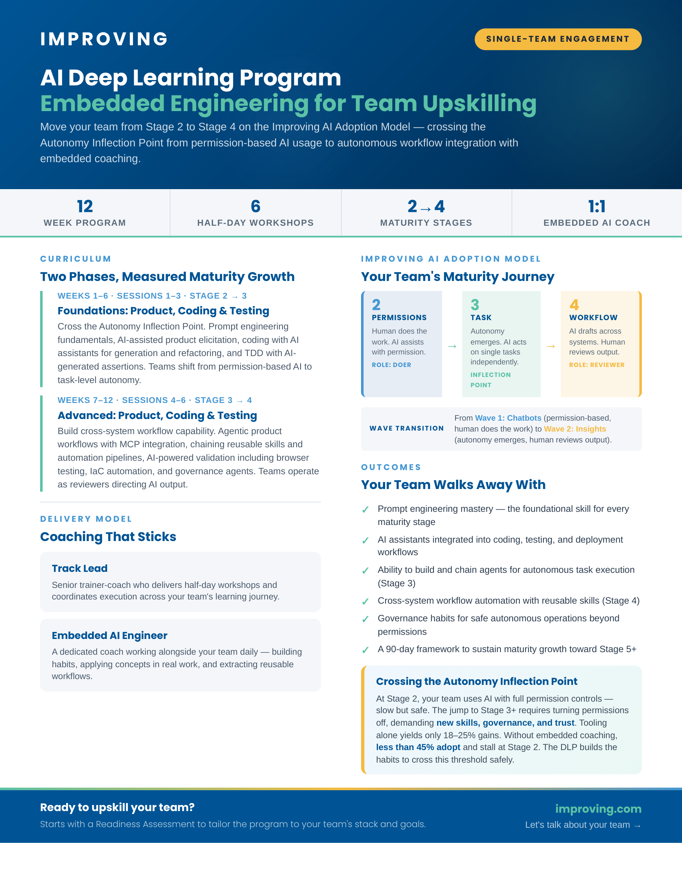
AI Deep Learning Program

Slide 12
AI Governance

